Slide 1
Vocabulary Corner
Design of Interactive Templates

Slide 2
Template 1 – Dictionary (Only Text)
Flow for this template is similar to the picture dictionary used in Early Edge.
Expected steps: 1) Teacher sees a list of words/phrases.
2) Teacher chooses the words/phrases she wishes to discuss.
3) Teacher submits selection.
4) Teacher goes through each slide using ‘Next’ button.
Each slide will have the word, its meaning and the example sentence. Voiceover will be available.
5) Teacher can go back to the home page at any point.

Slide 3
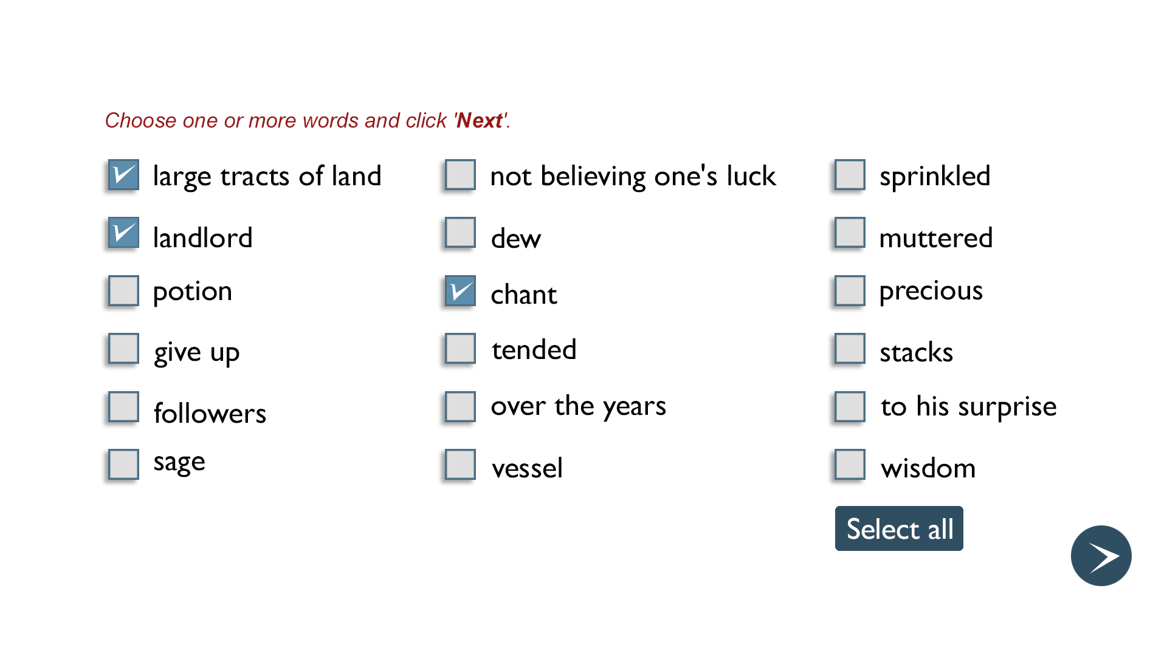
Screen 1

Slide 4
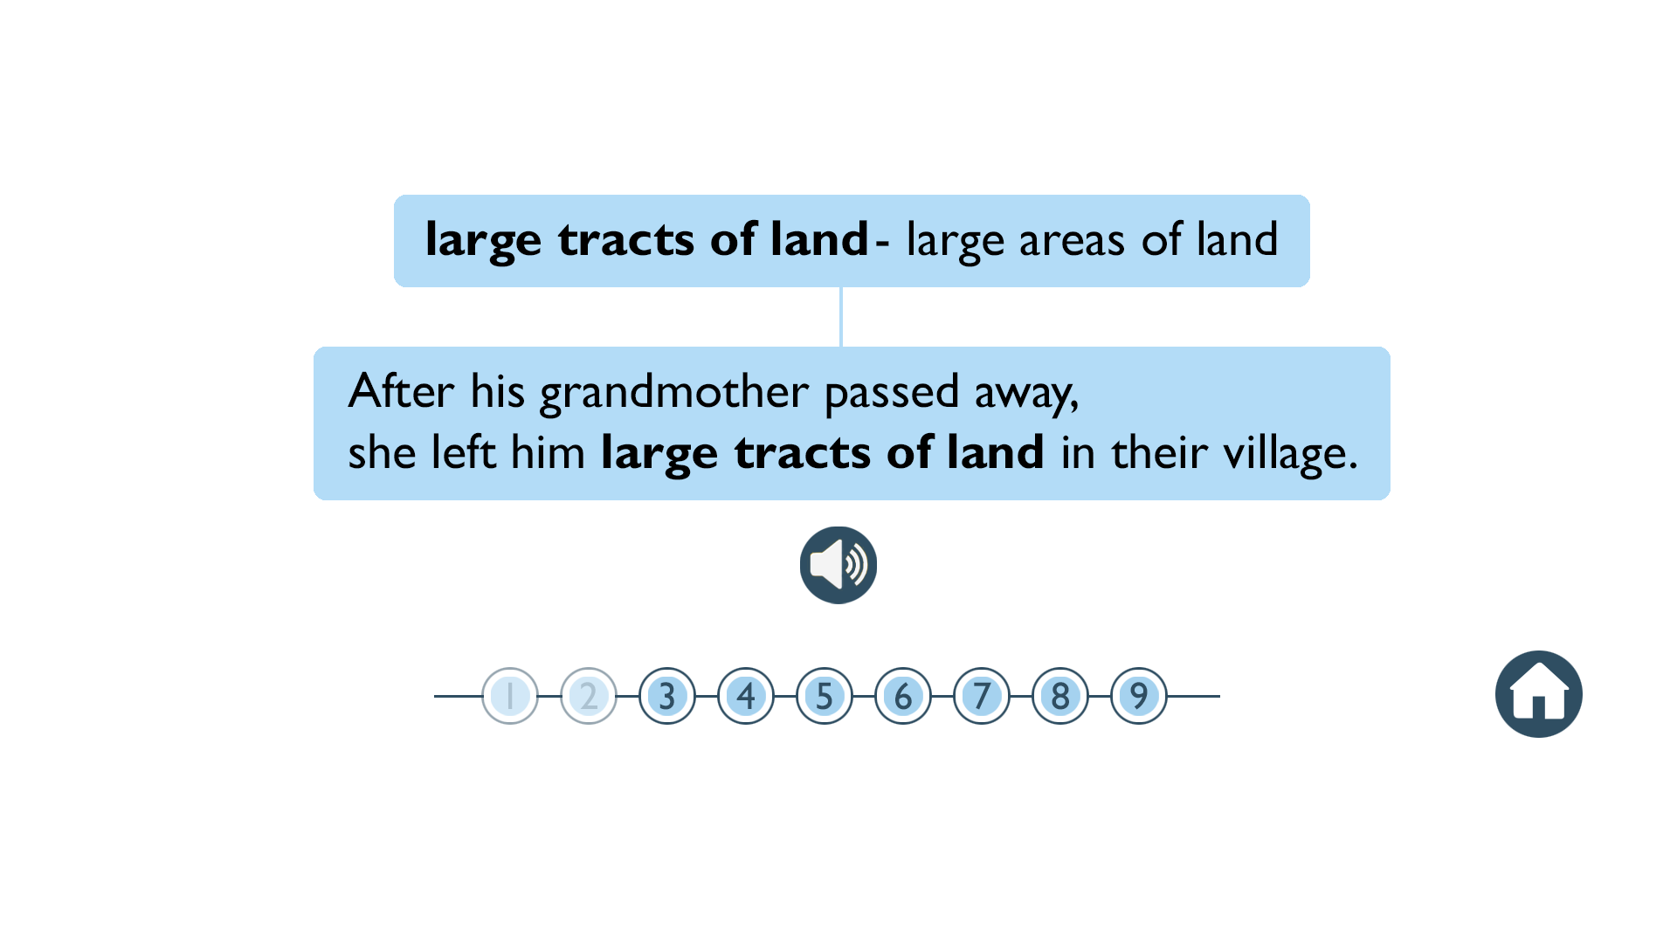
Screen 2

Slide 5
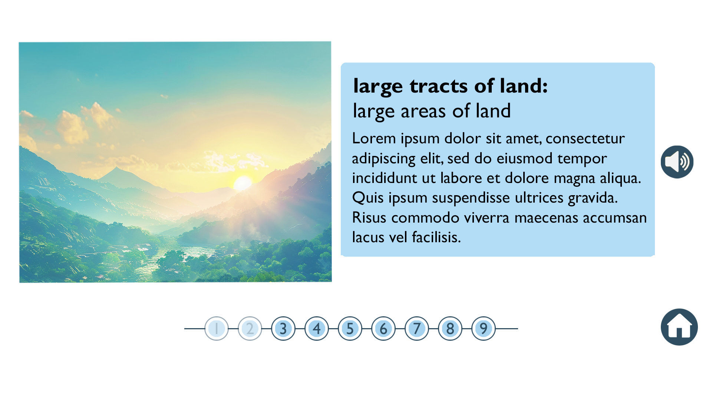
Template 2 – Dictionary (Text + Image)
Screen 2
A variant of template 2. Expected steps remain the same. Design of screen 2 will be a little different.

Slide 6
Template 2 – Matching (Text to text OR Text to Image)
Expected steps:
There will be two columns – both with text OR one with text and one with image.
Teacher will click on a word in column A and then on a word in column B. Immediate feedback will be provided on correct/incorrect choices.
A solution button will be available in case teacher wishes to reveal all answers.

Slide 7
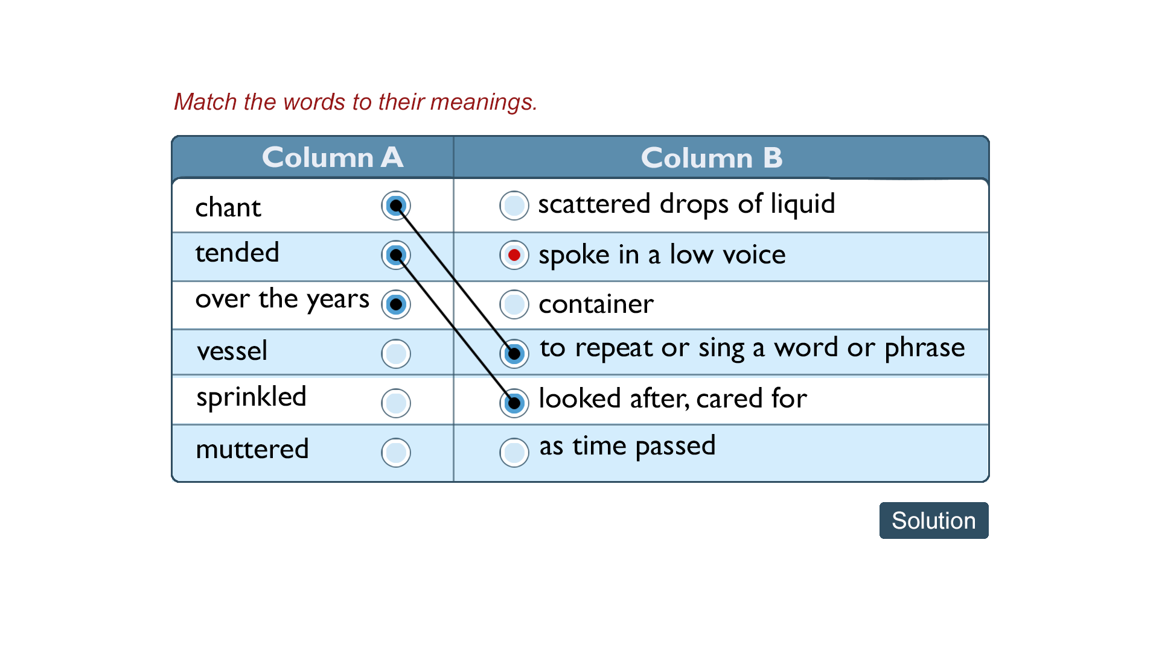
Screen 1
Note: If answer is incorrect, line will not form. Only the red dot will appear.

Slide 8
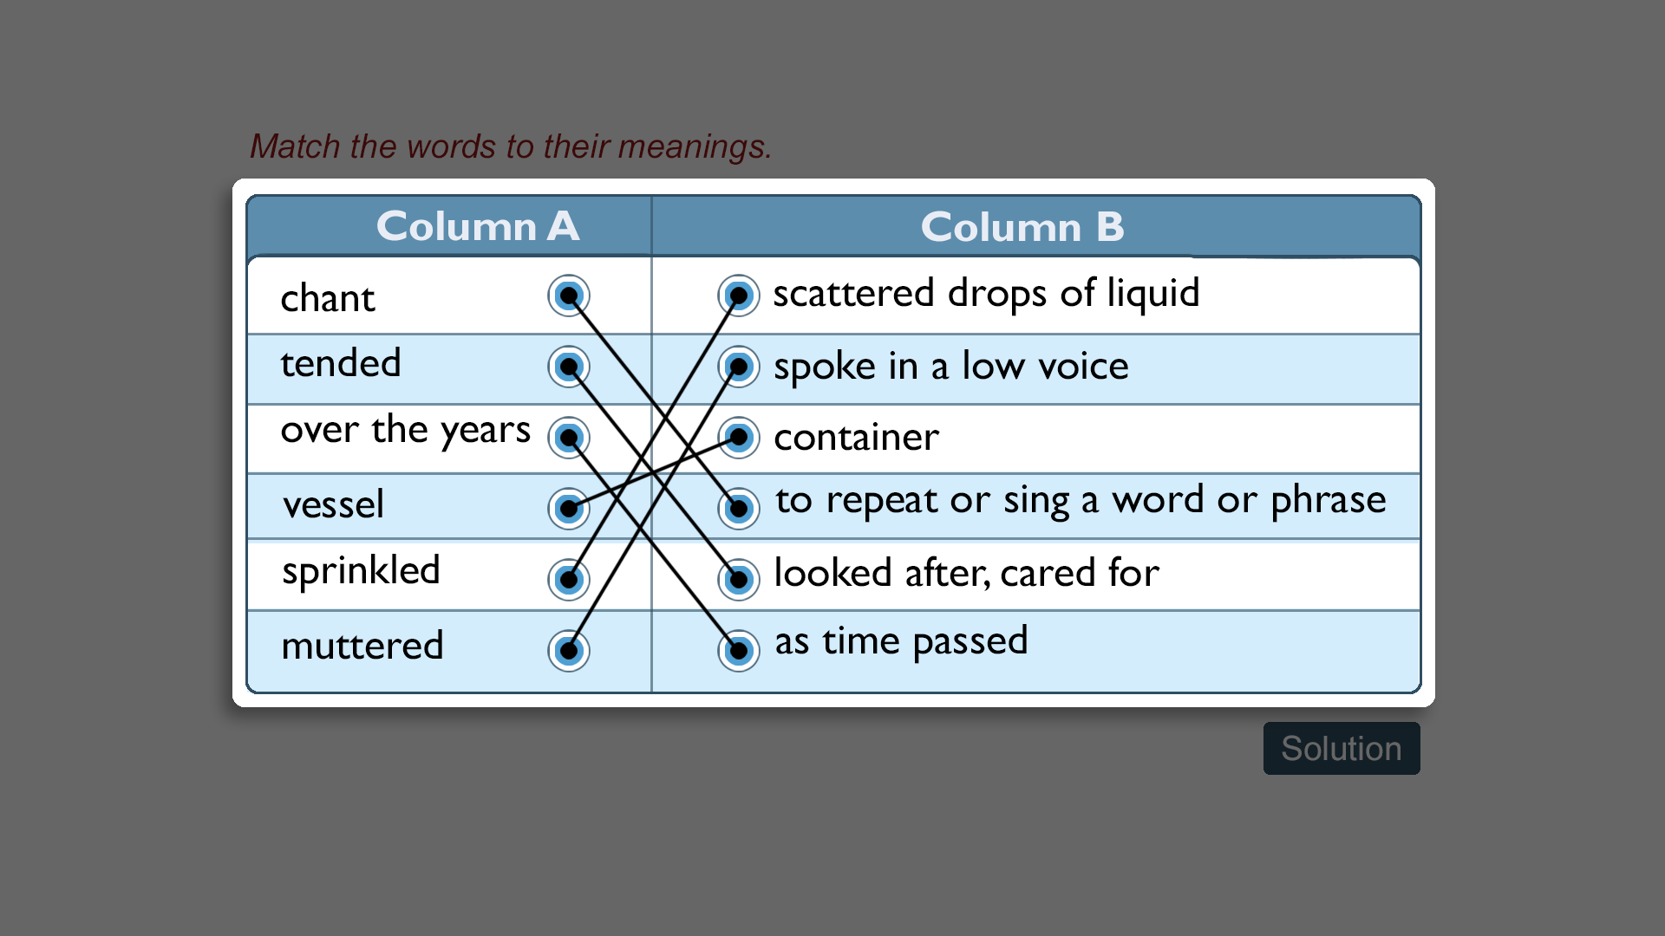
Screen 2 (Solution page)

Slide 9
Template 3 – Learn and Practice
Expected steps:
1) Teacher launches asset.
2) The first slide will be like screen 2 of dictionary. (Words and their meanings). VO button to be provided for each word and its meaning.
3) Teacher clicks 'Practice'.
4) An FIB exercise will play. Sentences with blanks will appear. The correct word or phrase needs to be chosen from the given help box. VO button to be provided for each sentence.

Slide 10
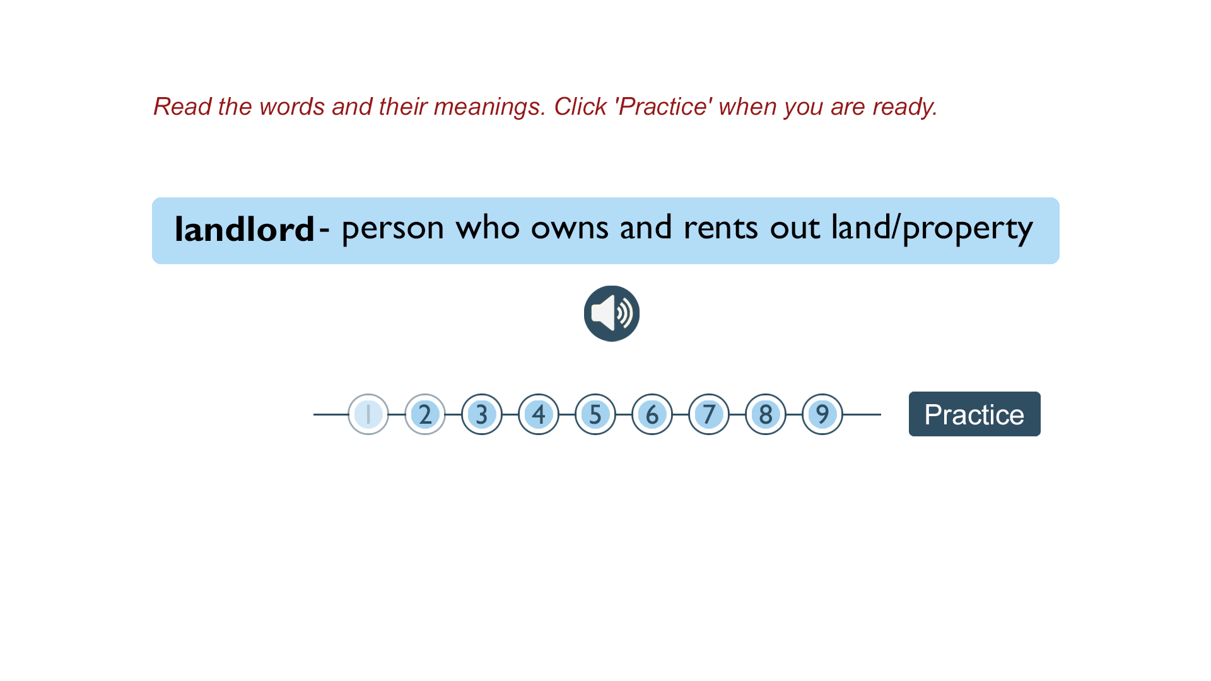
Screen 1

Slide 11
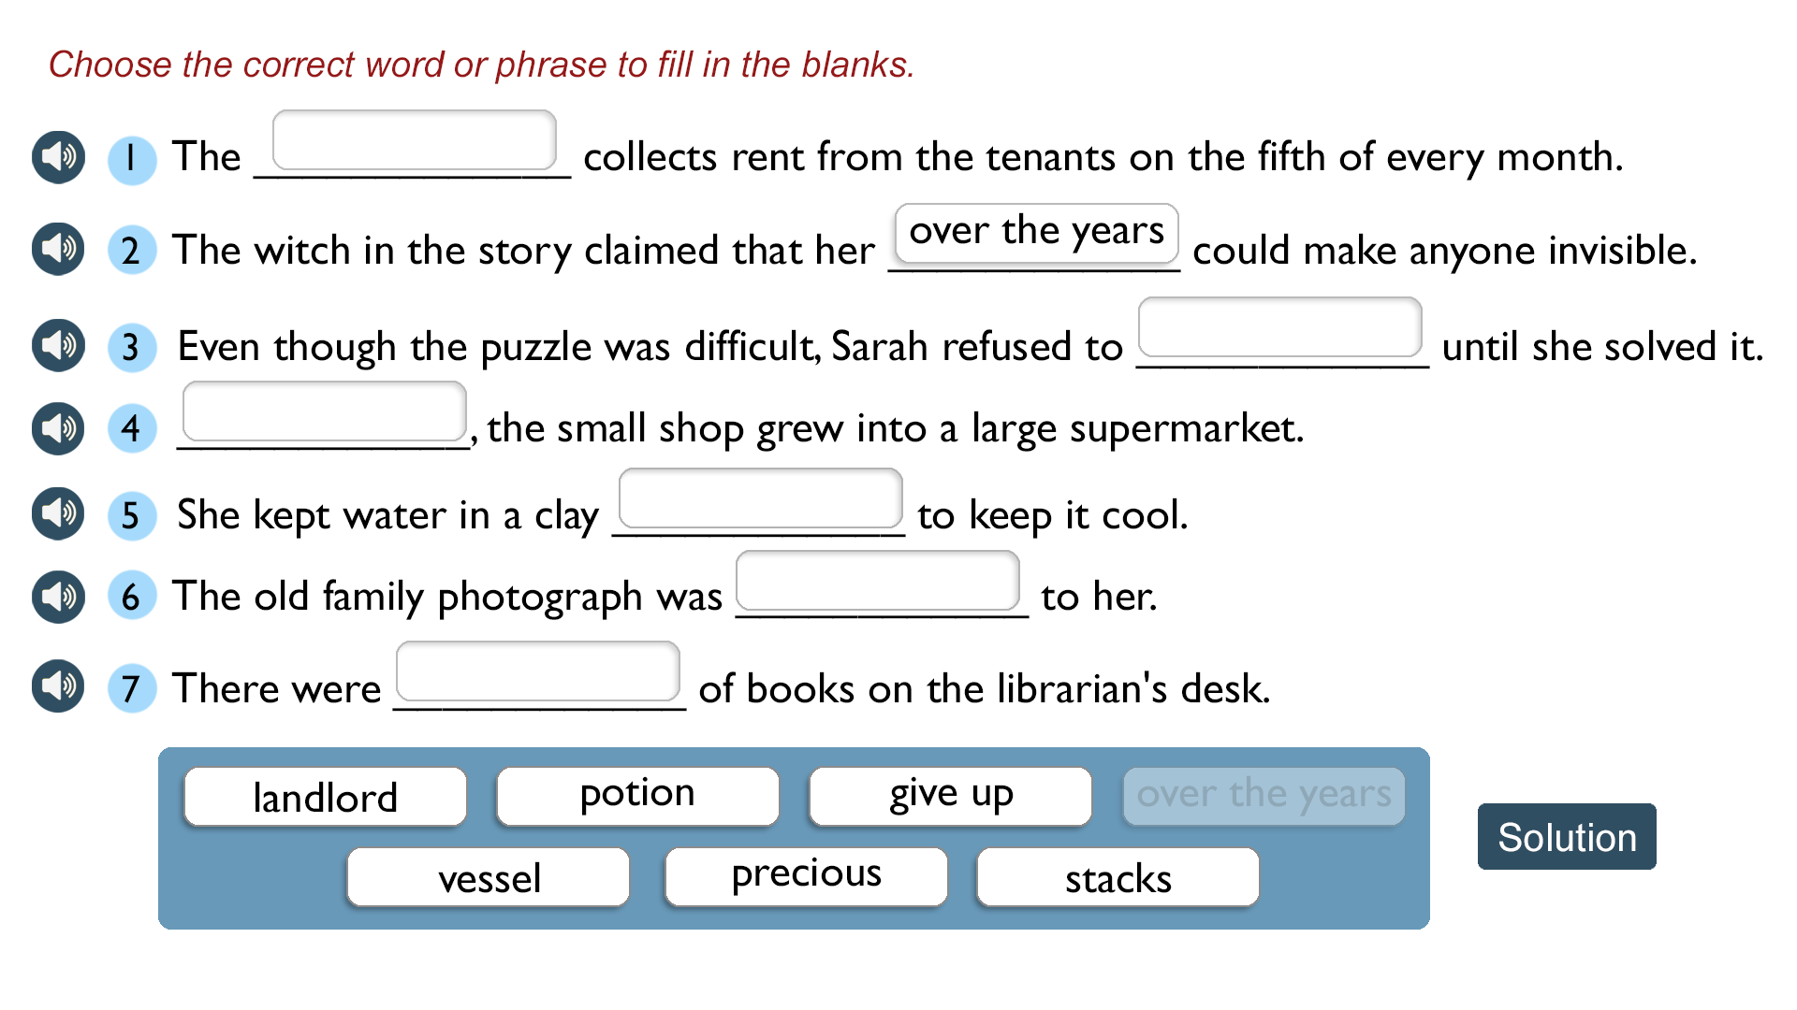
Screen 2

